Slide 1
Software Engineering Introduction

Slide 2
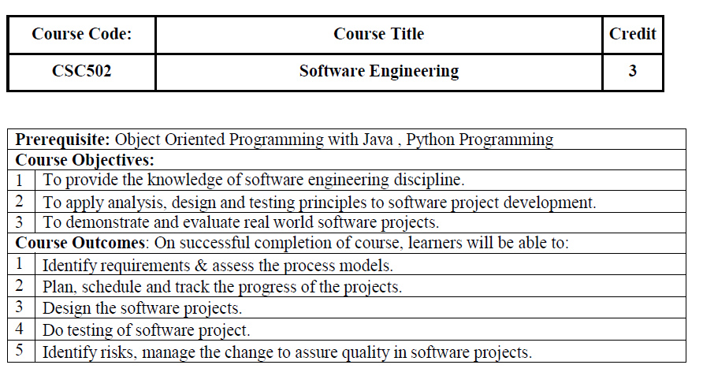

Slide 3
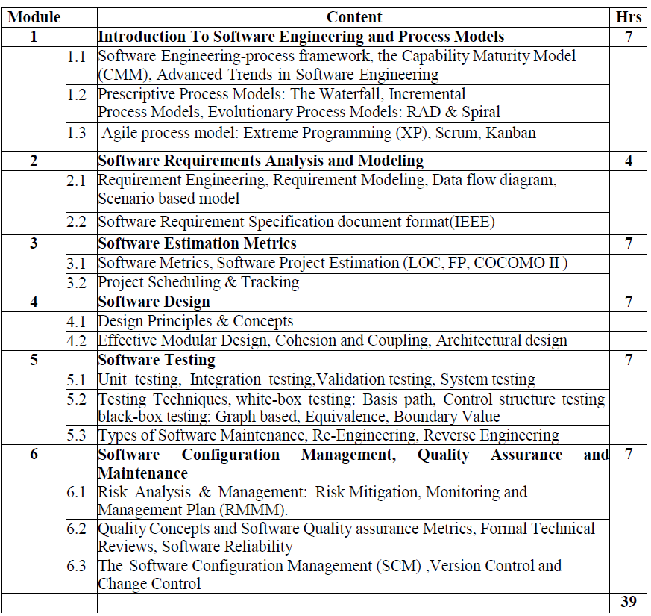

Slide 4
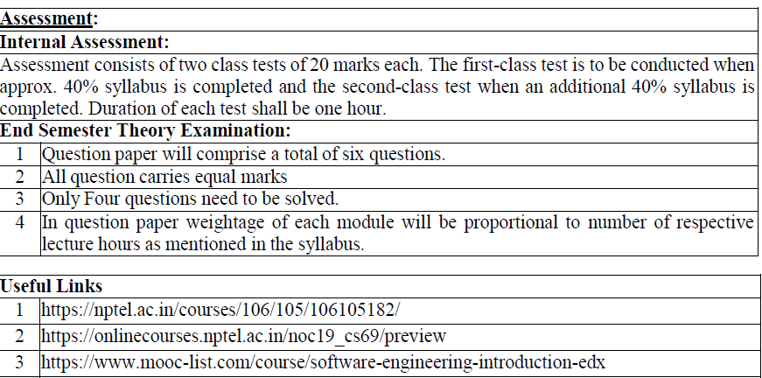

Slide 5
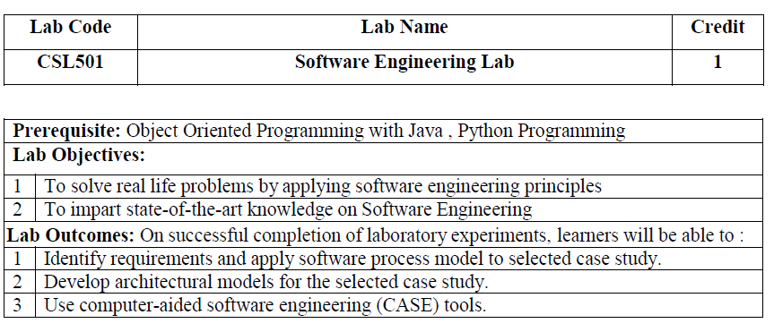
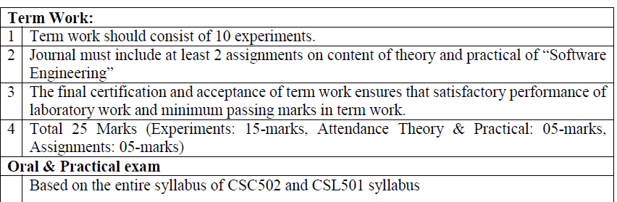

Slide 6
Engineering Definition
Systematically designing and manufacturing some product.
Application of science, tools and methods to find cost effective solution to problems

Slide 7
Software
Software is omnipresent in the lives of billions of human beings.
Software is an important component of the emerging knowledge based service economy.
Software or computer software consists of the computer program and its related documentation.
Software = computer program + documentation
The word ‘software’ was coined by John Tukey in 1958.
The theory behind the concept of a computer program were established by Alan Turing in the 1930’s.
The concept of a program as a sequence of steps to solve a problem is a realization of the concept of algorithm which was introduced by Muhammad Al-Khawarezmi, a 9th century mathematician.

Slide 8
Software (2)
Computer program
instructions that perform certain tasks on computer hardware.
can be written at different levels of closeness to the hardware.
Low level to high level languages
Documentation
plays a crucial role in the success of software.
of interest to the people using the software or to the people developing and maintaining it.
User manuals, installation procedures, and operating manuals are written mainly for the software users.

Slide 9
The software crisis (1967)
Characterized by the inability of existing techniques, tools and processes to deal with the increasing complexity of the needed software.
Main reasons: complexity of the software, changing and misunderstanding of requirements and the lack of tools and skilled professionals.
Produced software - low quality, hardly maintainable, and not meeting the stakeholder’s requirements.
Software projects were most of the time running over-budget and over-time, and many never delivered a functioning product.

Slide 10
The crisis persists …
According to the Standish Group, a software market research firm, 17% of software projects were complete failures in 2002. Moreover, 50 % of projects were not completed within the planned schedule, ran over-budget, or were missing some of the required features.
There are many concerns about the quality and reliability of the software we use. Existing software is plagued with millions of defects. Some of these defects are known and have already been detected, others are yet to be uncovered. These defects have caused many disasters leading to financial losses, physical harm to humans and life threatening situations.

Slide 11
Software Failures
Leap Year bug
Supermarket was fined $1000 did not considered 1988 as leap year
Interface misuse
London underground train left the station without its driver
Late & over budget
In 1995 bugs in automated luggage system of the new Denver International Airport caused suitcases to be chewed. Airport opened 16 months late with $3.2 billion over budget with manual luggage system

Slide 12
Software Failures (cont’d)
On-time delivery
After 18 months, $ 200 million system was delivered to a health insurance company in Wisconsin in 1984. did not worked and made $60 million overpayments were issued. System took three years to fix the bug
Unnecessary Complexity
C-17 cargo plane by McDonnell Douglas ran $500 million over budget because of problems in avionics software. 19 on-board computers, 80 microprocessors and 6 different types of programming languages were used

Slide 13
Software errors
Discovered and others are yet to be uncovered
25% are definition errors (requirements & specification)
25% design errors, 10% coding errors
It costs more to fix a definition error in the maintenance phase – better discover them early!

Slide 14
Software engineering
Software engineering is a term that was coined during the NATO Software Engineering conference held in Garmisch, Germany, in October 1968. The term was introduced by the conference chairman Friedrich Bauer.
SE is defined as systematic, disciplined and quantifiable approach for the development, operation and maintenance of software

Slide 15
Software Engineering Definition
‘the application of a disciplined approach for the development and maintenance of computer software’
‘deals with the establishment and use of sound engineering principles to economically obtain software that is reliable and works efficiently on real machines’ (by IEEE)
‘encompasses the use of tools, techniques and methods that are useful during the execution of the steps needed for the development of the software and its future maintenance’

Slide 16
Software Engineering: A Working Definition
Software Engineering is a collection of techniques, methodologies and tools that help with the production of A high quality software system developed with a given budget before a given deadline while change occurs with customer satisfaction:
Challenge: Dealing with complexity and change

Slide 17
Analogical Example
The K2 towers at 8.611 meters in the Karakorum range of the western Himalayas. It is the second highest peak of the world and is considered the most difficult to climb. An expedition to the K2 typically lasts several months in the summer when the weather is most favorable. Even in summer, snow storms are frequent. An expedition requires thousands of pounds of equipment, including climbing gear, severe weather protection gear, tents, food, communication equipment, and pay and shoes for hundreds of porters. Planning such an expedition takes a significant amount of time in the life of a climber and requires dozens of participants in supporting roles. Once on site, many unexpected events, such as avalanches, porter strikes, or equipment failures will force the climbers to adapt, find new solutions, or retreat. The success rate for expeditions to the K2 is currently less than 40%.

Slide 18
Example (cont’d)
In the above example discuss complex systems, where external conditions can trigger unexpected changes. Complexity puts the problem beyond the control of any single individual. Change forces participants to move away from well known solutions and to invent new solutions.
In above example, several participants need to cooperate and develop new techniques to address these challenges. Failure to do so results in the failure to reach the goal.
This subject is about conquering complex and changing software systems.

Slide 19
Software Engineering: A Problem Solving Activity
Analysis: – Understand the nature of the problem and break the problem into pieces
Synthesis: –Put the pieces together into a large structure
For problem solving we use techniques, methodologies and tools.

Slide 20
Introduction to software Engineering
Characteristics of software
Software is developed or engineered, it is not manufactured in the classical sense.
Software does not wear out. However it deteriorates due to change.
Software is custom built rather than assembling existing components.
-Although the industry is moving towards component based construction, most software continues to be custom built

Slide 21
Problems With Software Development
¤ Problems of requirements
¤ Problems of scale
¤ Problems associated with quality
¤ Problems of costs and schedules
¤ Problems of change and rework
¤ Problems of working in a group
¤ Maintenance issues
¤ Reusability considerations
¤ Social-economic-environmental influences

Slide 22
Poor systems
• Poor interface design
• Inappropriate data entry
• Incomprehensible error messages
• Unhelpful ‘help’
• Poor response time
• Unreliability in operation

Slide 23
An end-user’s perspective
• What system? I haven’t seen a new system
• It might work, but it’s dreadful to use!
• It’s very pretty, but does it do anything useful?

Slide 24
A client’s perspective
• If I’d known the real price, I’d never have agreed
• It’s no use delivering it now—we needed it last April!
• OK, so it works—but the installation was such a mess my staff will never trust it
• I didn’t want it in the first place
• Everything’s changed now—we need a completely different system

Slide 25
A developer’s perspective
• We built what they said they wanted
• There wasn’t enough time to do it any better
• Don’t blame me—I’ve never done object-oriented analysis before!
• How can I fix it?—I don’t know how it’s supposed to work
• We said it was impossible, but no-one listened
• The system’s fine—the users are the problem

Slide 26
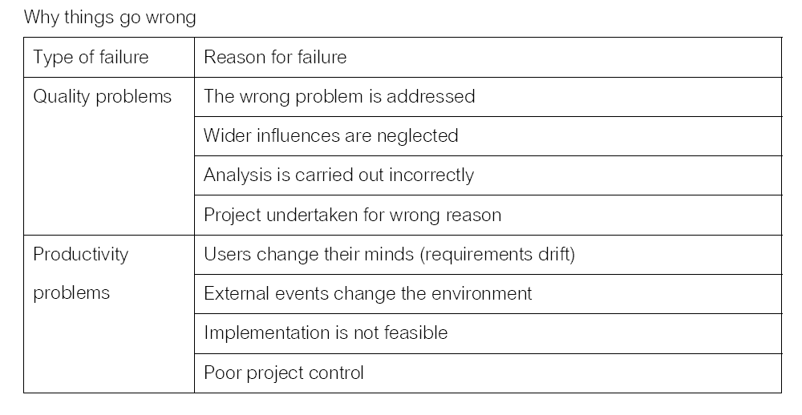

Slide 27
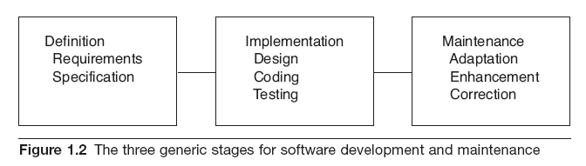
3 Generic stages in software development and maintenance
Structured, disciplined approach
Aiming at enhancing quality and dealing with complexity

Slide 28
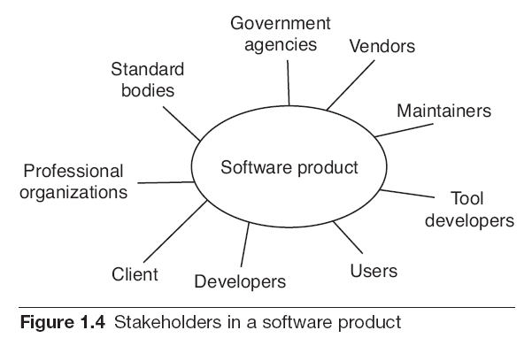

Slide 29
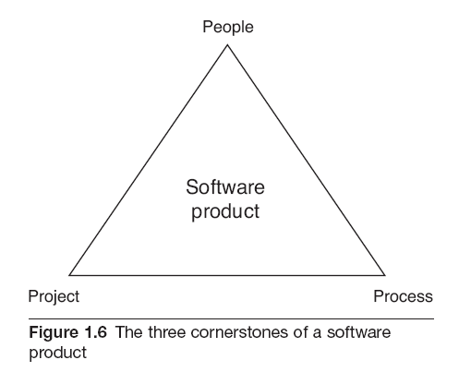

Slide 30
SOFTWARE MYTHS
Widely held but false view
Propagate misinformation and confusion
Three types of myth
Management myth
Customer myth
Practitioner’s myth

Slide 31
MANAGEMENT MYTHS
Myth(1)
-The available standards and procedures for software are enough.
Myth(2)
-Each organization feel that they have state-of-art software development tools since they have latest computer.
Myth(3)
-Adding more programmers when the work is behind
schedule can catch up.
Myth(4)
-Outsourcing the software project to third party, we can relax and let that party build it.

Slide 32
CUSTOMER MYTH
Myth(1)
- General statement of objective is enough to begin writing programs, the details can be filled in later.
Myth(2)
-Software is easy to change because software is flexible

Slide 33
PRACTITIONER’S MYTH
Myth(1)
-Once the program is written, the job has been done.
Myth(2)
-Until the program is running, there is no way of assessing the quality.
Myth(3)
-The only deliverable work product is the working
program
Myth(4)
-Software Engineering creates voluminous and unnecessary documentation and invariably slows down software development.

Slide 34
Desirable software abilities – user-centered
Availability is the degree to which the software system is available when its services are required. It can be quantified as the ratio of the actual availability of the software services to the expected availability during the same period.
Correctness is the degree to which the software meets its requirements specifications. Correctness is affected positively by the completeness, consistency, and traceability of the software. Accuracy is a qualitative assessment of correctness.
Efficiency is the degree to which the software system performs its functions using the least amount of computational and memory resources.
Integrity is the degree to which the software system prevents unauthorized access to information or programs. Both integrity and availability contribute to the security of the software system.

Slide 35
Desirable software abilities – user-centered (2)
Reliability is the ability of a software system to perform its function under stated conditions and for a specified period of time. Reliability can be quantified using the mean time between failures. Reliability is positively affected by error recoverability and fault tolerance, modularity and simplicity, and other quality factors.
Scalability is the ability of the software system to handle a growing number of user requests up to a certain specified limit.
Usability is the degree of ease with which the software system can be used. Usability is positively affected by learnability, readability, understandability, and other quality factors

Slide 36
Desirable software abilities – developer-centered
Flexibility is the measure of how easily the software system can be extended or expanded. Flexibility is positively affected by the simplicity, generality, and modularity of the software, and other quality factors.
Interoperability is ability of the software system to exchange information with other external systems.
Maintainability is the measure of how easily the software system can be modified to fix errors, to improve its functions or to adapt it to different environments. Maintainability is positively affected by adaptability, simplicity, modularity and traceability, and other quality factors.

Slide 37
Desirable software abilities – developer-centered (2)
Portability is the ease with which the software system can be moved to a different software or hardware environment or platform. Portability is positively affected by generality and modularity, and other quality factors.
Reusability is the degree of ease with which a software component can be reused in the same software system or used to build new systems. Reusability is positively affected by generality and modularity, and other quality factors.
Testability is the measure of how easily test cases can be selected and executed to test the software. Testability is positively affected by modularity, simplicity and traceability, and other quality factors.

